Slide 1
Internet Control Message Protocol (ICMP)

Slide 2
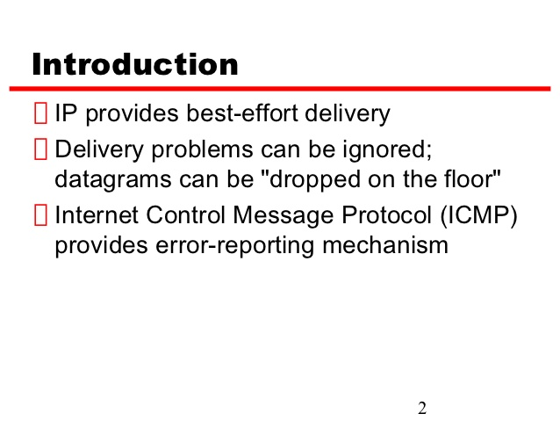

Slide 3
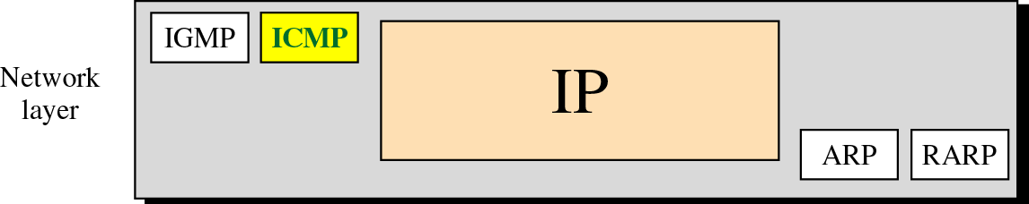
Figure 9-1
Position of ICMP in the network layer

Slide 4
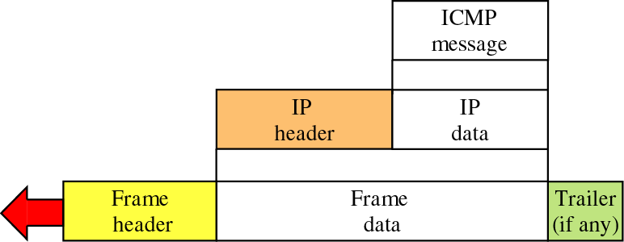
Figure 9-2
Encapsulation of ICMP packet

Slide 5
9.1
TYPES
OF
MESSAGES

Slide 6
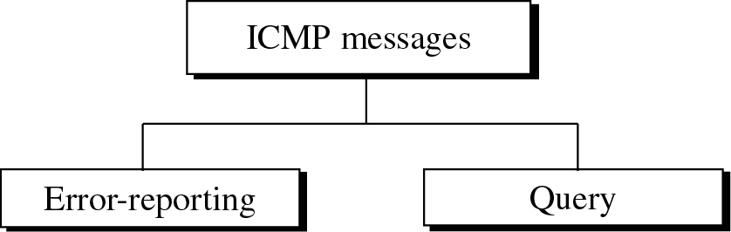
Figure 9-3
ICMP messages

Slide 7
9.2
MESSAGE
FORMAT

Slide 8
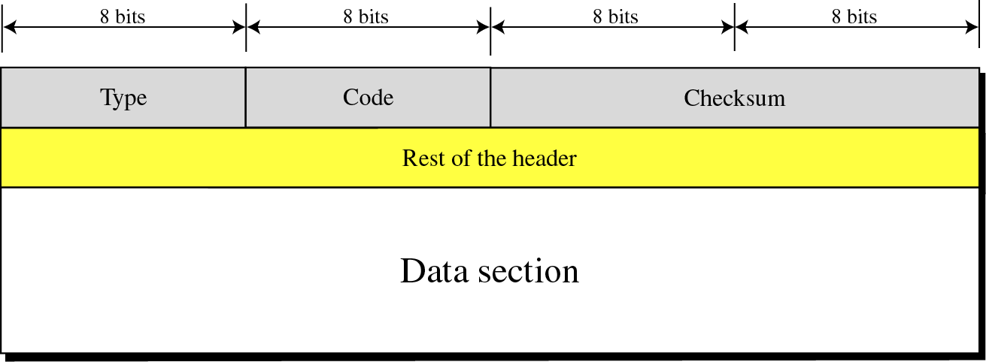
General format of ICMP messages

Slide 9
An ICMP message has an 8-byte header and a variable-size data section.
Although the general format of the header is different for each message type, the ﬁrst 4 bytes are common to all.
The ﬁrst ﬁeld, ICMP type, deﬁnes the type of the message.
The code ﬁeld speciﬁes the reason for the particular message type.
The last common ﬁeld is the checksum ﬁeld. The rest of the header is speciﬁc for each message type.
The data section in error messages carries information for ﬁnding the original packet that had the error.
In query messages, the data section carries extra information based on the type of the query.

Slide 10
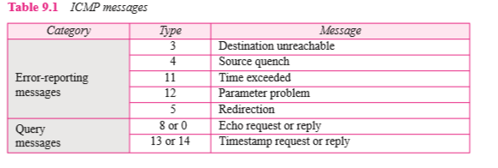

Slide 11


Slide 12

ICMP always reports error messages to the original source.

Slide 13
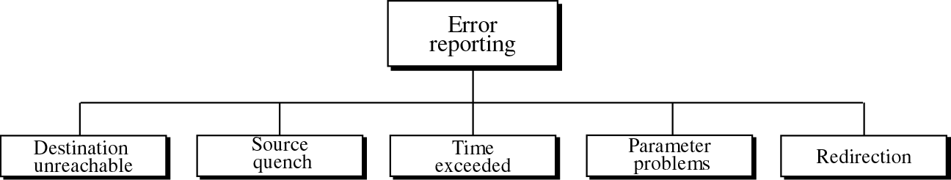
Figure 9-5
Error-reporting messages

Slide 14
The following are important points about ICMP error messages:
❑ No ICMP error message will be generated in response to a datagram carrying an ICMP error message.
❑ No ICMP error message will be generated for a fragmented datagram that is not the ﬁrst fragment.
❑ No ICMP error message will be generated for a datagram having a multicast address.
❑ No ICMP error message will be generated for a datagram having a special address such as 127.0.0.0 or 0.0.0.0.

Slide 15
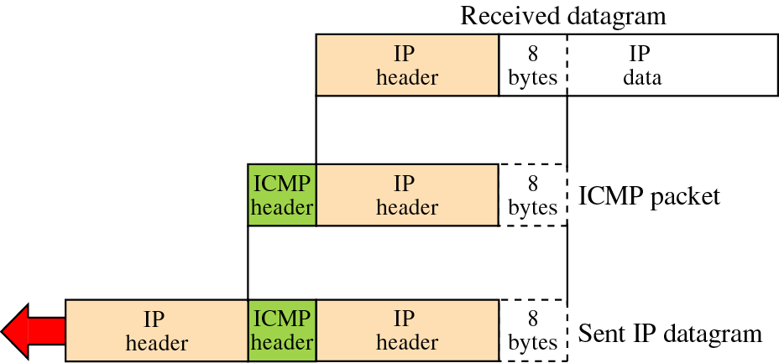
Figure 9-6
Contents of data field for error messages

Slide 16
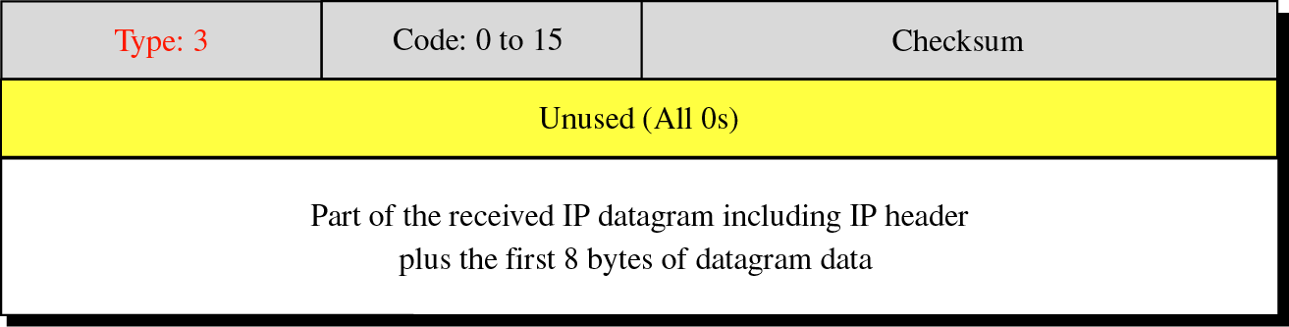
Figure 9-7
1. Destination-unreachable format

Slide 17
When a router cannot route a datagram or a host cannot deliver a datagram, the datagram is discarded and the router or the host sends a destination-unreachable message back to the source host that initiated the datagram.

Slide 18
Destination-unreachable messages with codes 2 or 3 can be created only by the destination host. Other destination-unreachable messages can be created only by routers.

Slide 19
A router cannot detect all problems that prevent the delivery of a packet.

Slide 20
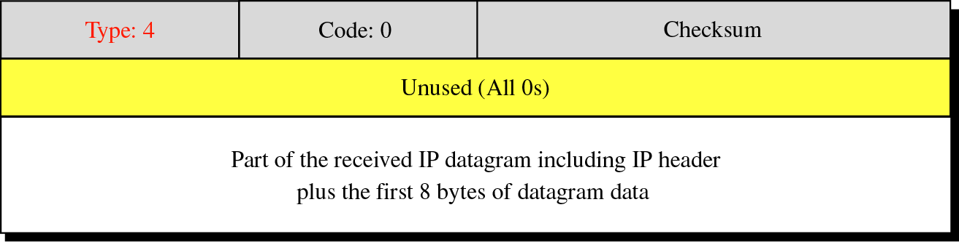
Figure 9-8
2. Source-quench format

Slide 21
A source-quench message informs the source that a datagram has been discarded due to congestion in a router or the destination host.
The source must slow down the sending of datagrams until the congestion is relieved.

Slide 22
One source-quench message should be sent for each datagram that is discarded due to congestion.

Slide 23
3. Time Exceeded
Whenever a router receives a datagram with a time-to-live value of zero, it discards the datagram and sends a time-exceeded message to the original source.

Slide 24
When the final destination does not receive all of the fragments in a set time, it discards the received fragments and sends a time-exceeded message to the original source.

Slide 25
In a time-exceeded message, code 0 is used only by routers to show that the value of the time-to-live field is zero. Code 1 is used only by the destination host to show that not all of the fragments have arrived within a set time.

Slide 26
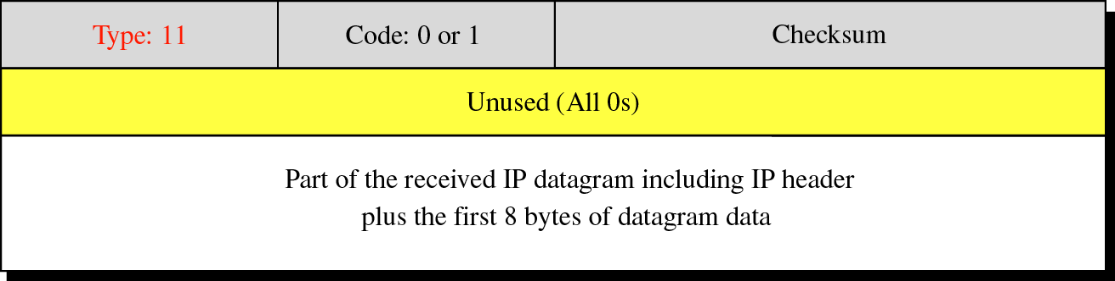
Figure 9-9
Time-exceeded message format
Code 0: Time to live Code 1: Fragmentation

Slide 27
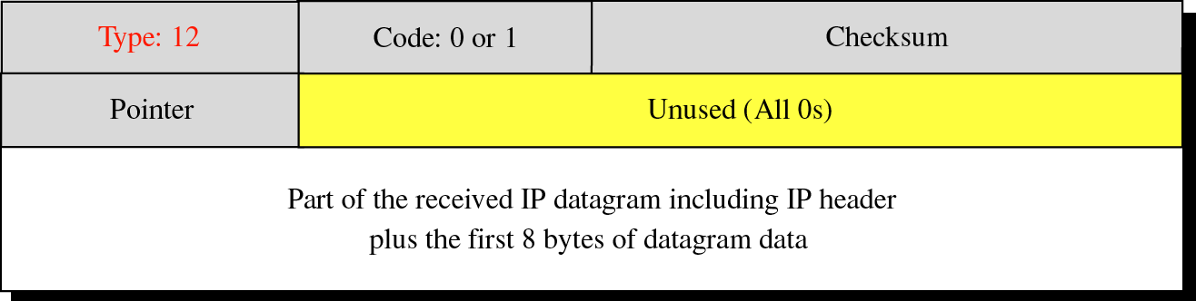
Figure 9-10
4. Parameter-problem message format
Code 0: Main header problem Code 1: Problem in the option field

Slide 28
Any ambiguity in the header part of a datagram can create serious problems as the data- gram travels through the Internet.
If a router or the destination host discovers an ambiguous or missing value in any ﬁeld of the datagram, it discards the datagram and sends a parameter-problem message back to the source.

Slide 29
A parameter-problem message can be created by a router or the destination host.

Slide 30
5. Redirection
A host usually starts with a small routing table that is gradually augmented and updated. One of the tools to accomplish this is the redirection message.

Slide 31
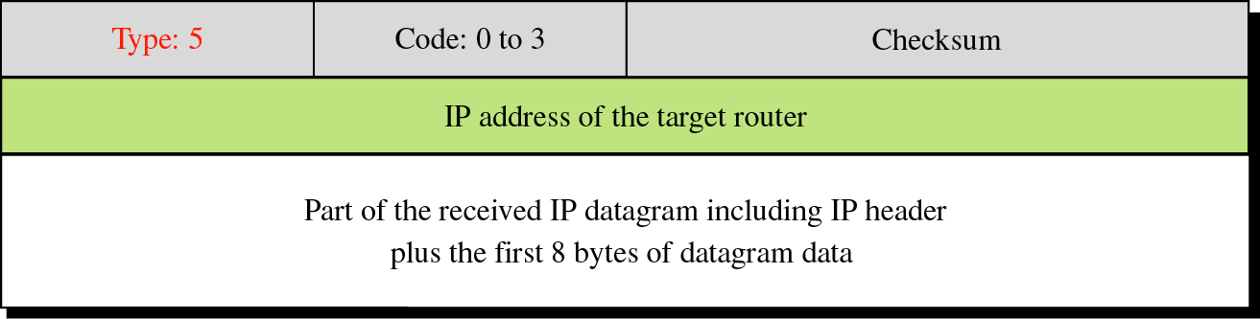
Figure 9-12
Redirection message format
Code 0: Network specific Code 1: Host specific Code 2: Network specific (specified service)
Code 3: Host specific (specified service)

Slide 32
When a host considered, its routing table has a limited number of entries.
It usually knows only the IP address of one router, the default router.
For this reason, the host may send a datagram, which is destined for another network, to the wrong router.
In this case, the router that receives the datagram will forward the datagram to the correct router.
However, to update the routing table of the host, it sends a redirection message to the host.
As shown in the picture below

Slide 33
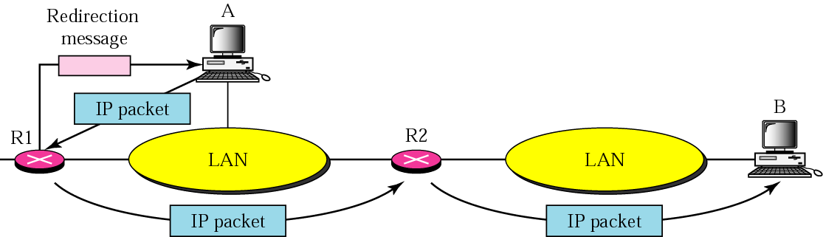
Figure 9-11
Redirection concept

Slide 34
Host A wants to send a datagram to host B.
Router R2 is obviously the most efﬁcient routing choice, but host A did not choose router R2.
The datagram goes to R1 instead.
R1, after consulting its table, ﬁnds that the packet should have gone to R2.
It sends the packet to R2 and, at the same time, sends a redirection message to host A.
Host A’s routing table can now be updated.

Slide 35
QUERY MESSAGES

Slide 36
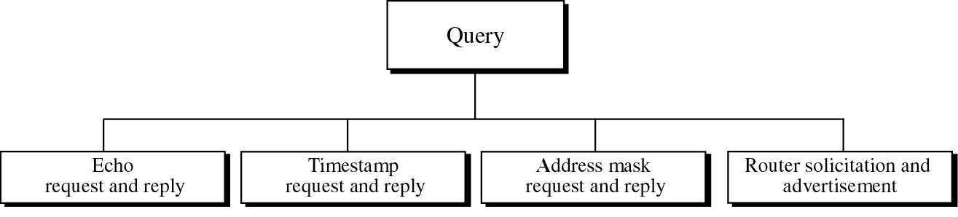
Figure 9-13
Query messages
In addition to error reporting, ICMP can also diagnose some network problems.
This is accomplished through the query messages.
Only two pairs are used today: echo request and replay and timestamp request and replay.

Slide 37
Echo Request and Reply
Designed for diagnostic purposes.
Network managers and users utilize this pair of messages to identify network problems.
The combination of echo-request and echo-reply messages determines whether two systems (hosts or routers) can communicate with each other.

Slide 38
An echo-request message can be sent by a host or router. An echo-reply message is sent by the host or router which receives an echo-request message.

Slide 39
Echo-request and echo-reply messages can be used by network managers to check the operation of the IP protocol.

Slide 40
Echo-request and echo-reply messages can test the reachability of a host. This is usually done by invoking the ping command.

Slide 41
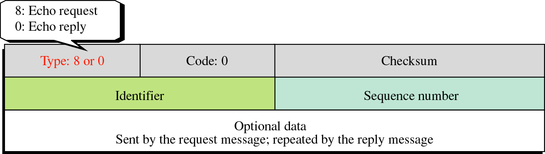
Figure 9-14
Echo-request and echo-reply message format
Ping command can use
theses messages.

Slide 42
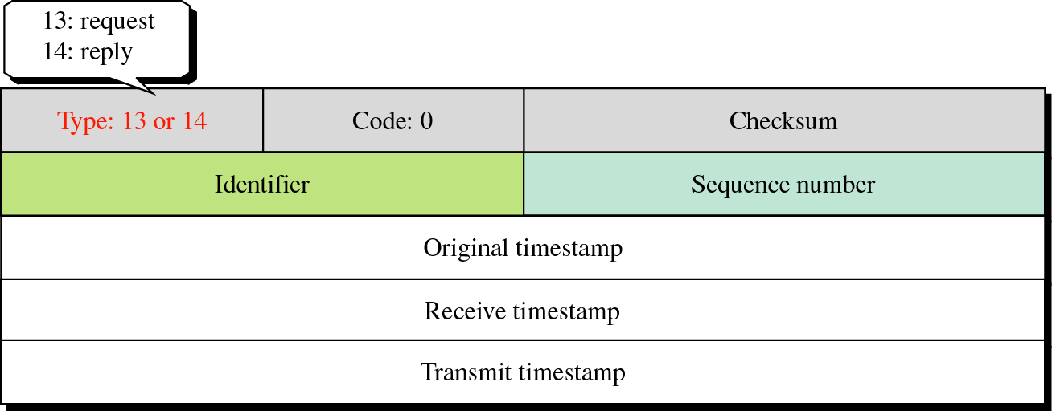
Figure 9-15
Timestamp-request and
timestamp-reply message format

Slide 43
Timestamp-request and timestamp-reply messages can be used to calculate the round-trip time between a source and a destination machine even if their clocks are not synchronized.

Slide 44
To determine the round-trip time needed for an IP datagram to travel between two machines.

Slide 45
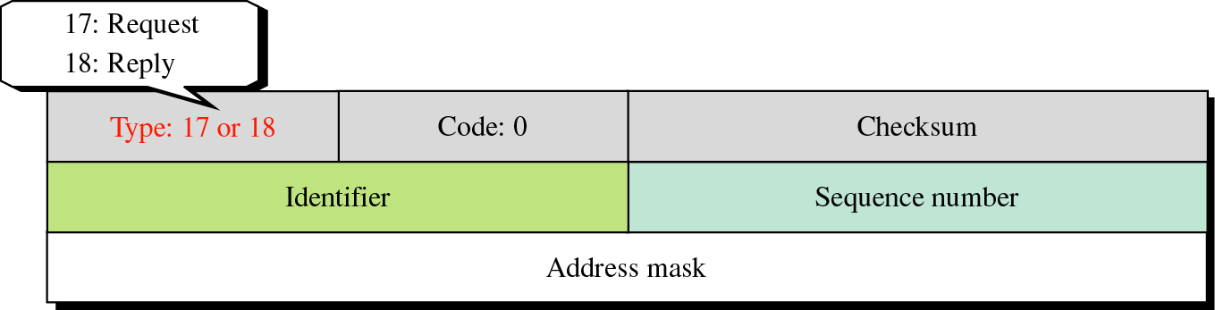
Figure 9-16
Address Mask-request and mask-reply message format
To know the network mask of corresponding IP address, address-mask-request is sent.

Slide 46
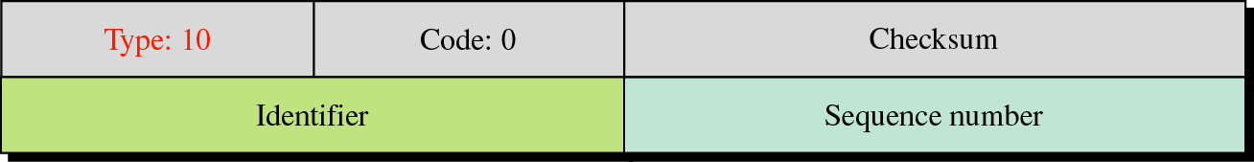
Figure 9-17
Router solicitation message format
to discover the routers on the same link.
A host can broadcast router solicitation message.
A router or routers that receives the solicitation message broadcast their routing information using router–advertisement messages.

Slide 47
CHECKSUM
In ICMP the checksum is calculated over the entire message (header and data).
Debugging tools that uses ICMP message
: ping
: trace route

